Slide 1
Trends in IP video surveillance - 2015
Tsvetan Filev <tsvetan.filev@gmail.com>

Slide 2
History
CCTV – Close Circuit Television
Introduced in 1940 by the Germans for monitoring Rockets
US 1949 – Vericon
UK, US 1960 – Wide spread
VHS (Video Home System) – 1980s
Multiplexing recorders – 1990s (480x640 – 0.3 Megapixels)
HDD - Middle 1990s (analog to digital)
NetEye200 from Axis communications. 1 FPS, 17 sec to generate an image. JPEG – Joint Photographic Experts Group. Axis founded in 1984.
VMS – end of 1990s
VSAAS – 2000s
4k video (3840x2160) – 2010s
20 Mpixel

Slide 3
Domains
Cities
Airports
Retail
Schools
Police
Concerts
Power plants
Military
Production

Slide 4
Components of a VMS
Video
Audio
Events
Output relays
EDGE storage
Metadata
PTZ

Slide 5
Video
Live, Record, Search, Evidence lock
Codecs – MJPEG, MPEG4, H.263, H.264, H.265
Compression – JPEG, MPEG (I frames, P frames, B frames, GOP)
Parameters – FPS, Resolution, Bitrate, JPEG quality, image settings
Streaming – transport (RTPS/RTP over UDP, TCP, HTTP)

Slide 6
MPEG/H.264
Source: https://en.wikipedia.org/wiki/Inter_frame

Slide 7
OSI and Internet model

Slide 8
Streaming (RTSP/RTP)

Slide 9
RTSP communication

Slide 10
Audio
Codecs – AAC, G.711, G.726
Two way audio

Slide 11
Events
Digital inputs
Motion detection
Line crossing
Video loss
Temperature
Audio level
Object appear/disappear
Object direction/speed
Face detection
Loitering
Stopped vehicle
Scream
SD card

Slide 12
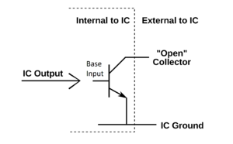
Output relays
Dry circuit – open collector
Control of doors, windows, alarms, motors, etc.

Slide 13
EDGE storage
SD card storage
Retrieve audio/video if network is down

Slide 14
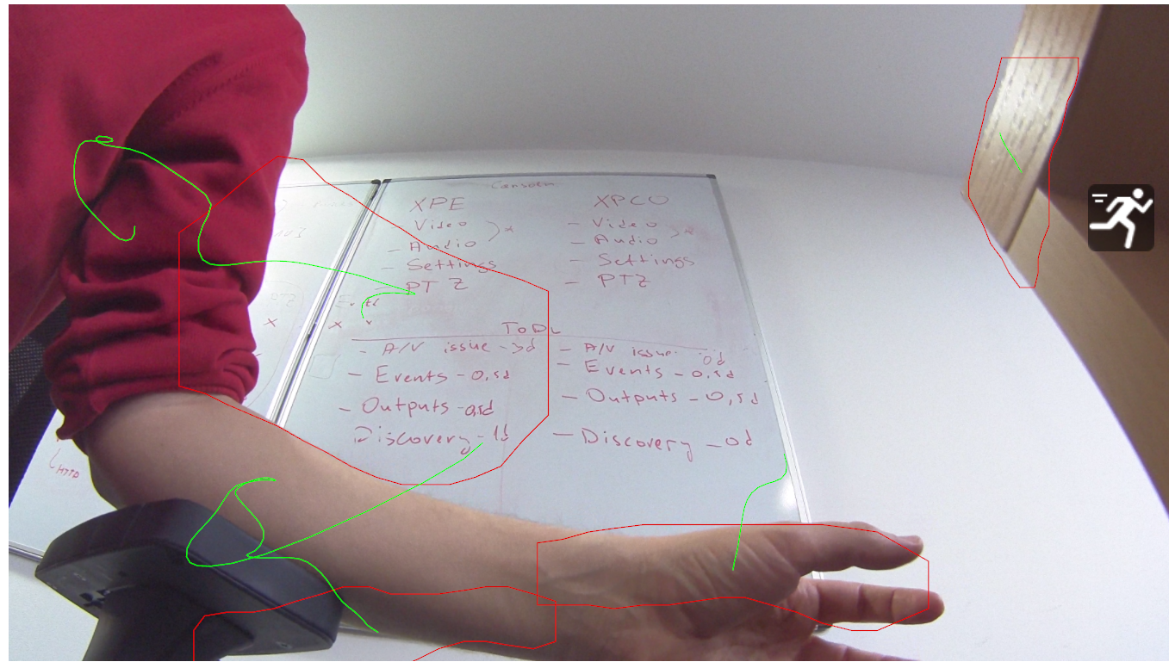
Metadata
Bounding boxes
Moving objects

Slide 15
PTZ
Pan/Tilt/Zoom
Move the sensor to a given position and zoom
Patrolling

